Slide 1
WELCOME

Slide 2
PRESENTATION ON STATIC PROJECT
ZOMATO Pizzaro
Presented By:
Dhanshree Lokhande
Guided By:
Jayant V

Slide 3
CONTENT
Introduction of Topic
Languages Used/Tools
Screenshots of Website

Slide 4
INTRODUCTION
In this Static Project, I have created a website having the online facility to order the Pizza and having meal too.

Slide 5
LANGUAGES / TOOLS USED
Languages Used:
HTML
CSS
Tool Used:
Sublime Text

Slide 6
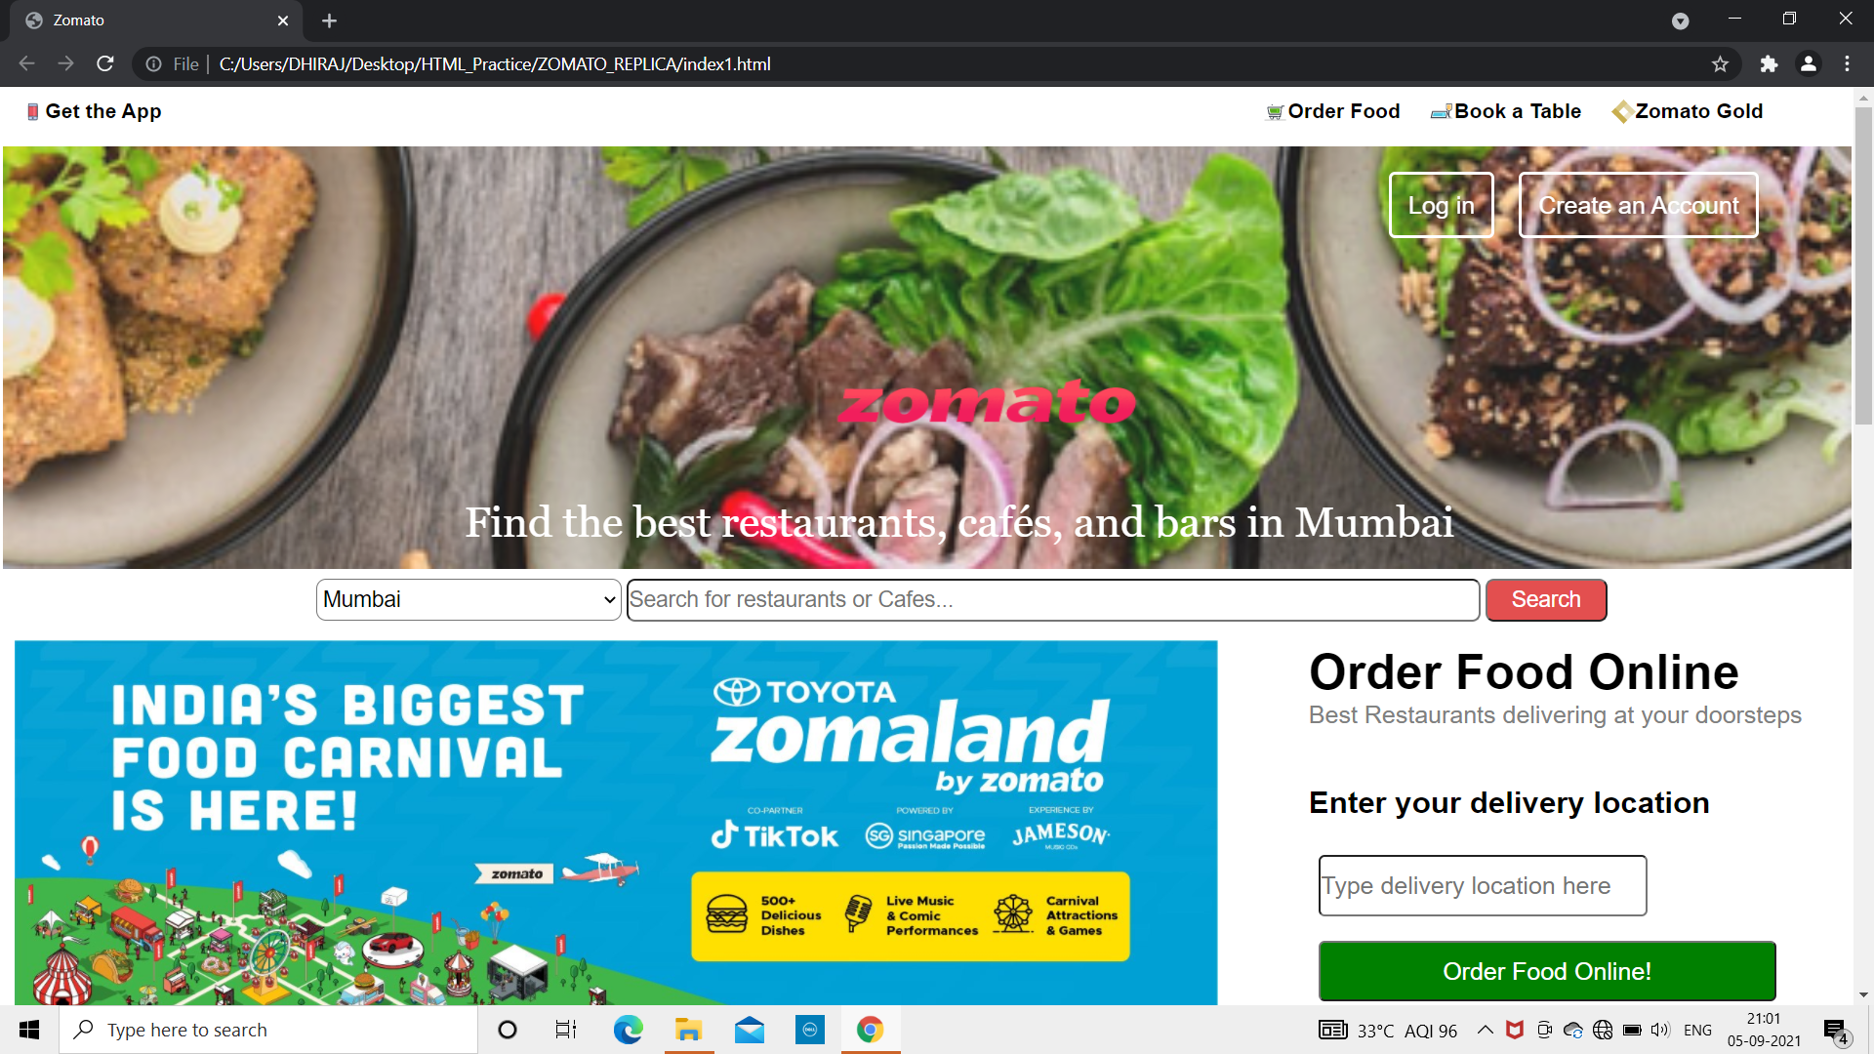
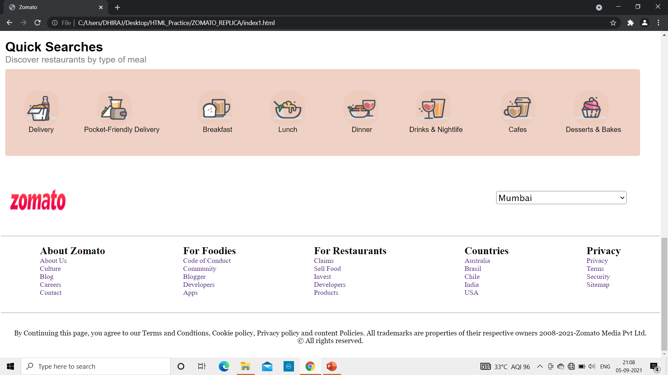
Screenshots of Website
Home Page

Slide 7
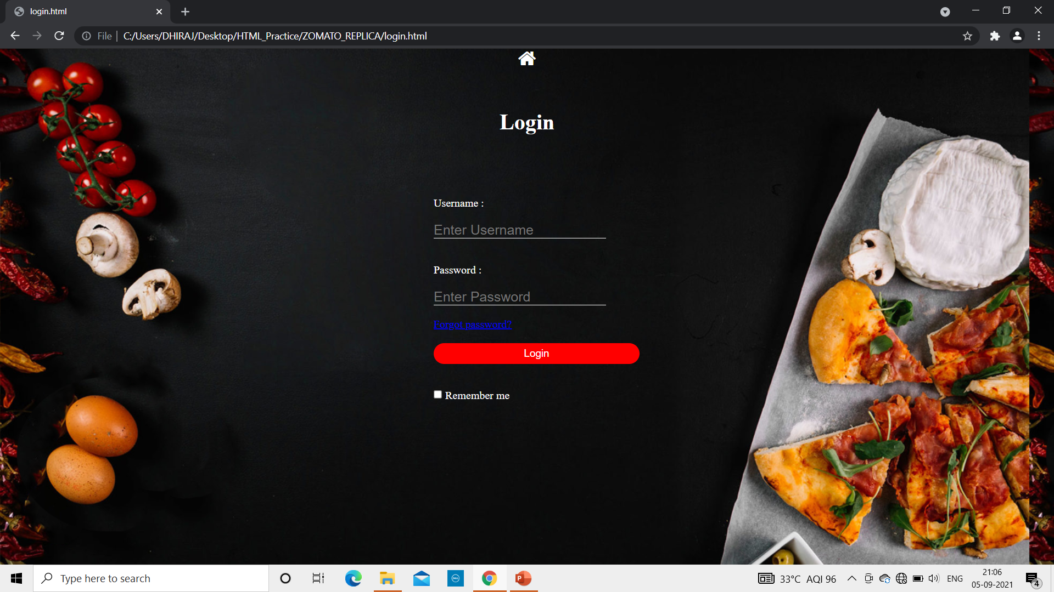
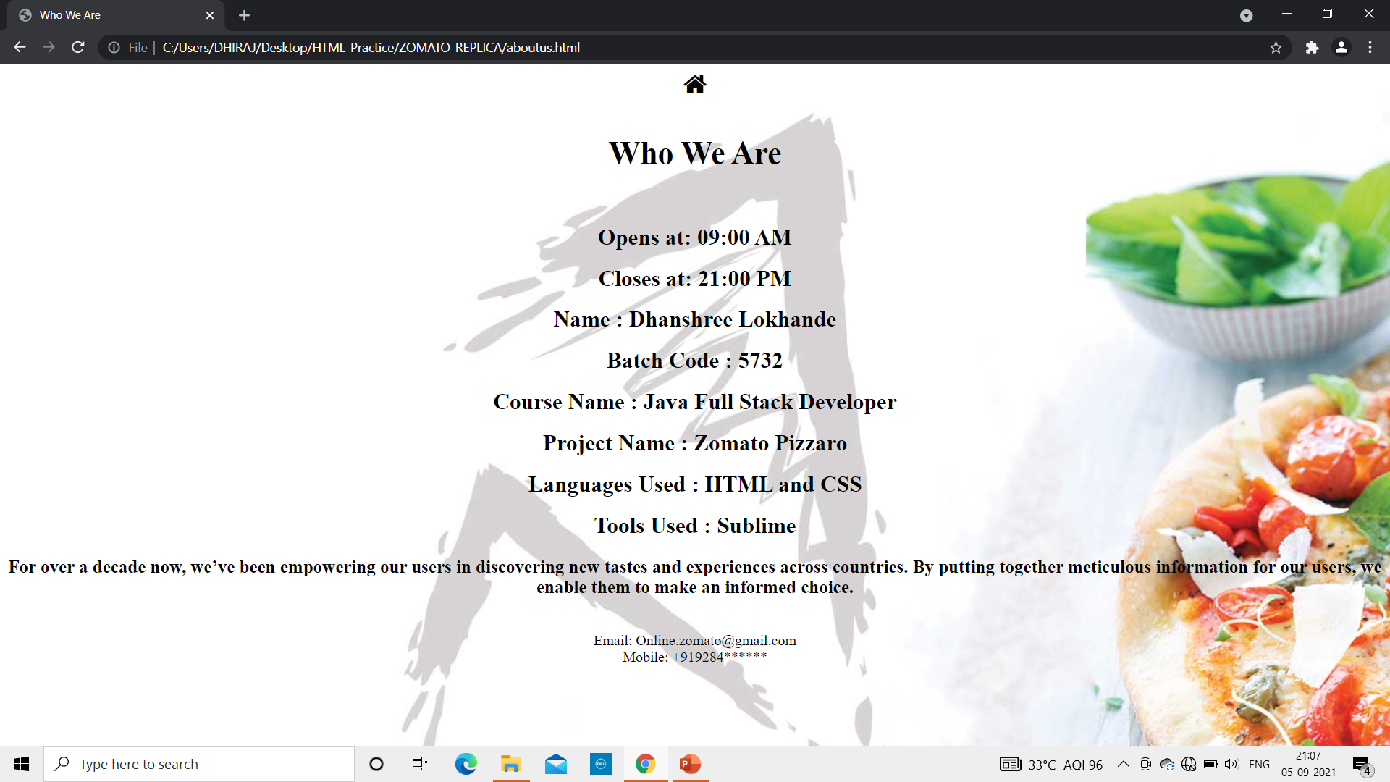
Login Page
About Us Page

Slide 8
THANK YOU
Lets have a look on website…

